Slide 1





MS Visual Studio – Part 1
C++ Set-Up for Algo Quant Trading
By Nicholas Burgess

Slide 2

C++ Set-Up for Algo Quant Trading
Part 1 – Visual Studio for Windows
Online C++ Emulators & Code Snippets
Visual Studio Projects & Solutions
C++ Building, Compilation & Linking
Part 2 – CMake for Cross-platform Builds
The CMake Build System
How to use CMake
Build Environments & Compilers
Example: Visual Studio & CMake https://github.com/nburgessx/QuantResearch/tree/main/CMake%20Examples

Slide 3
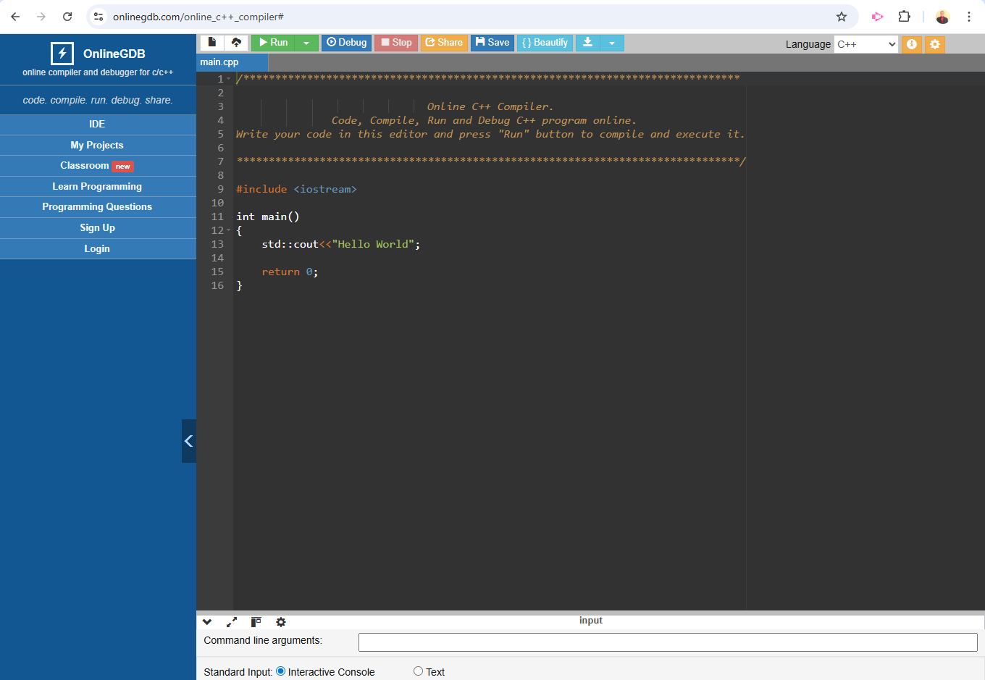

C++ Online Emulator
Can Select Language (top-right)
C++, Python, Java …
Can Select Version
C++14, C++17, C++23 …
Great for Learning C++ Syntax & Testing Ideas
Great for Code Snippets, Sharing & Debugging
Links nicely with GitHub
Online C++ Compiler
https://www.onlinegdb.com/online_c++_compiler#

Slide 4
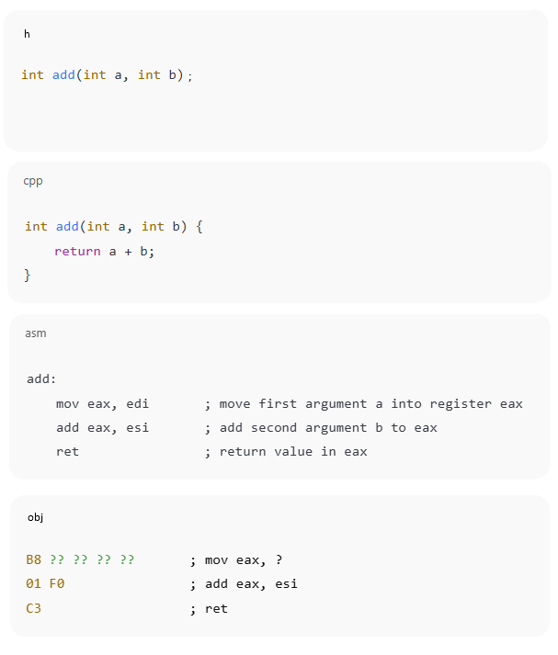
C++ Header and Source Files
1. Header Files (.h)
Here we declare our functions, classes & interfaces
2. Source Files (.cpp)
Define and implement the header file declarations
Contain the actual code logic
3. Object Files (.obj)
Source code from .cpp is compiled into an object file
It is first translated into assembly language .asm
The assembler then creates the object file .obj
Object files contain binary machine code ready for linking

Slide 5
C++ Build Process – Compile & Link
1. Compile (cl.exe)
Expands #include directives and checks syntax and types
Converts each translation unit (.cpp file) into an object file
2. Link (link.exe)
Verifies all symbols (i.e. functions and global variables) are defined
Combines object files into a single file (.exe | .lib | .dll)
3. Generated Output Files
Object Files: These are compiled .cpp files (Windows .obj | Linux/macOS .o)
Static Library: A library (.lib) or collection of object files merged together
Dynamic Linked Library (DLL): Compiled code loaded at runtime (.dll)
Executable: A fully linked program ready to run (.exe)

Slide 6
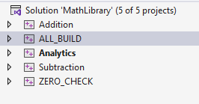
Connecting Projects & Using Libraries
Connecting Projects Example: Solution & Projects
In C++ project folders are independent
To share projects internally, we typically compile them as libraries (.lib)
To use them we reference the path to the include directory (header files)
and the path to and name of the .lib file
To share projects externally we compile as them as a library, executable or DLL
When using Libraries - Why are headers needed? Sharing Projects
Headers declare what exists (functions, classes, interfaces) - Header file path(s)
Libraries contain how it’s implemented (compiled machine code) - Library file path

Slide 7
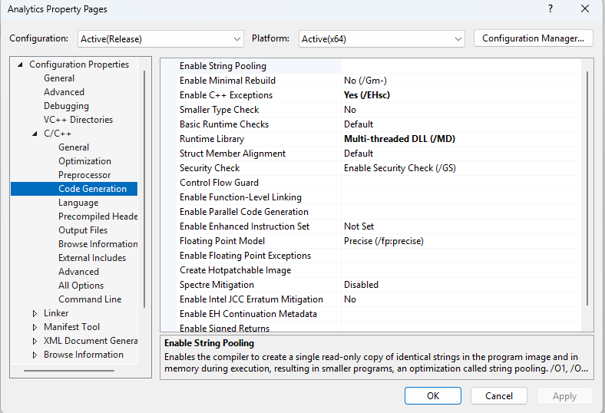
Application Binary Interface (ABI)
ABI defines how project binaries are linked and how they manage memory
Projects sharing runtime resources e.g. std::vector or FILE* must use the same C++ Runtime library (CRT), which handles memory, I/O and startup support
Dynamic Linkage (/MD) links against a shared C++ Runtime DLL (CRT)
Static Linkage (/MT) embeds a private CRT into each binary
Mixing /MD and /MT is unsafe – such code often builds successfully but fails and crashes at runtime
Rule of thumb:
/MD → DLLs & large apps (shared runtime, one-heap)
/MT → Fully self-contained tools (no shared ownership)

Slide 8
Visual Studio

Slide 9
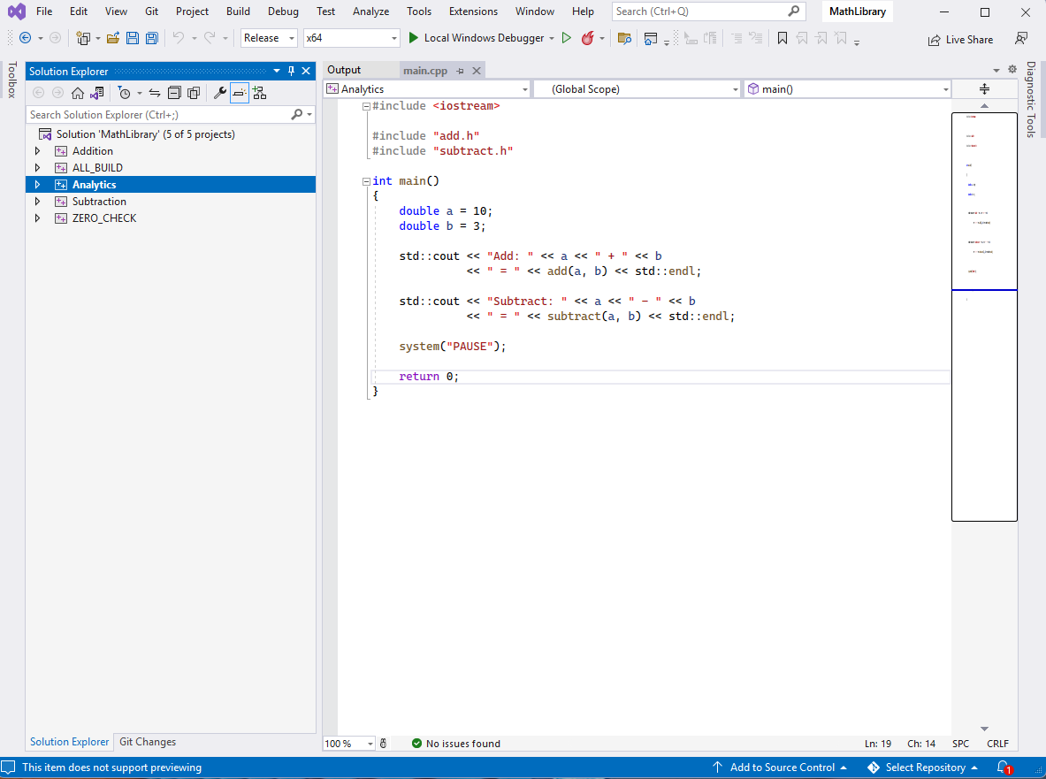
Visual Studio
Solution File
Start-Up Project
Project Dependencies (Build Order)
Configuration
Debug, Release, Custom
Can Include/Exclude Projects
Project Files
Independent Code Project Groups
Features
Source Control – Git Integration
Command Line – Dev Command Prompt
External Tools – Custom Tools / Scripts
Extensions – e.g. Incredibuild

Slide 10
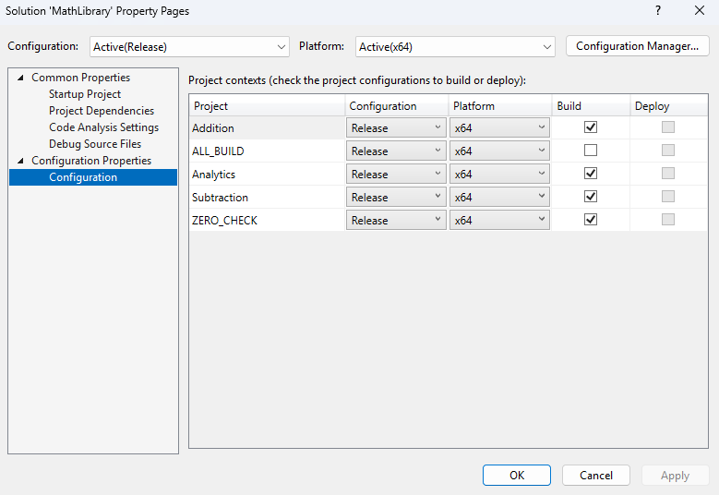
Visual Studio Solution & Projects Files These are XML files in disguise – Try opening them in notepad!

Slide 11
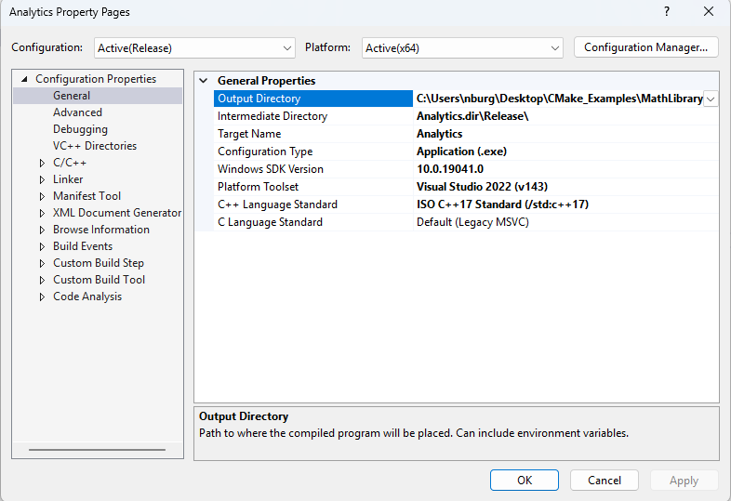
Visual Studio Project Properties
Output type
Configuration Type (.lib | .exe | .dll)
Where outputs go
Intermediate Directory (.obj)
Output Directory (.lib | .exe | .dll)
Solution and Project Files [TOP TIP]
These are XML files that can be opened in Notepad
XML supports extra features e.g. recursive file paths

Slide 12
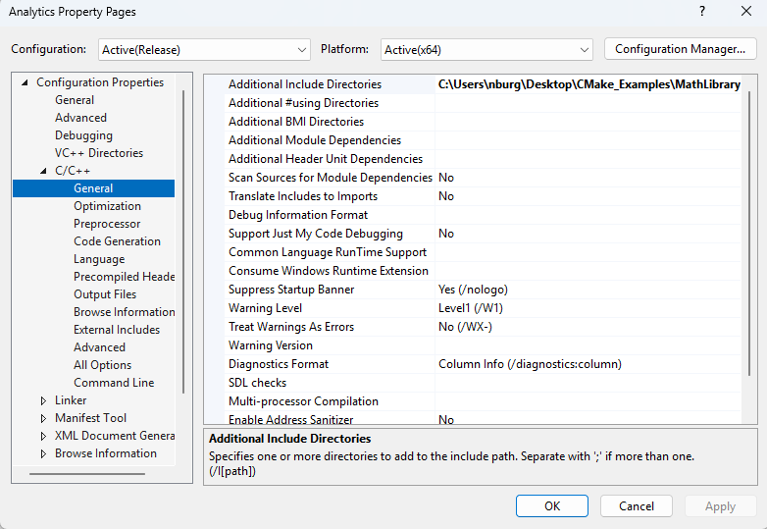
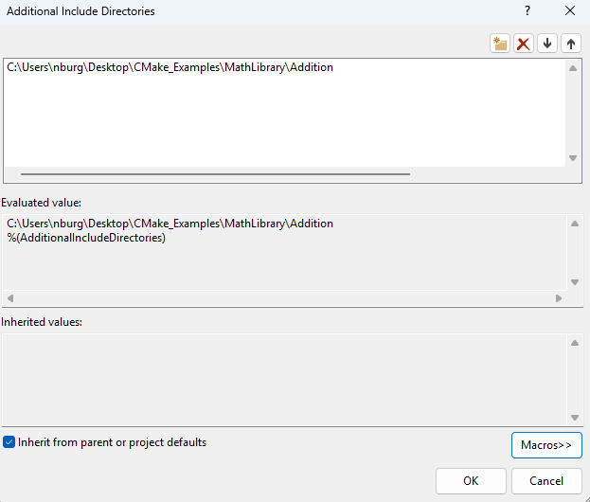
VS Project Properties – C/C++ Compiler
File Path Macros [TOP TIP]
Click the down arrow on any directory folder, then in the window pop-up press the “Macros” button
View existing file path variables (macros) and/or add new ones e.g. $(SolutionDir), $(ProjectDir), …

Slide 13
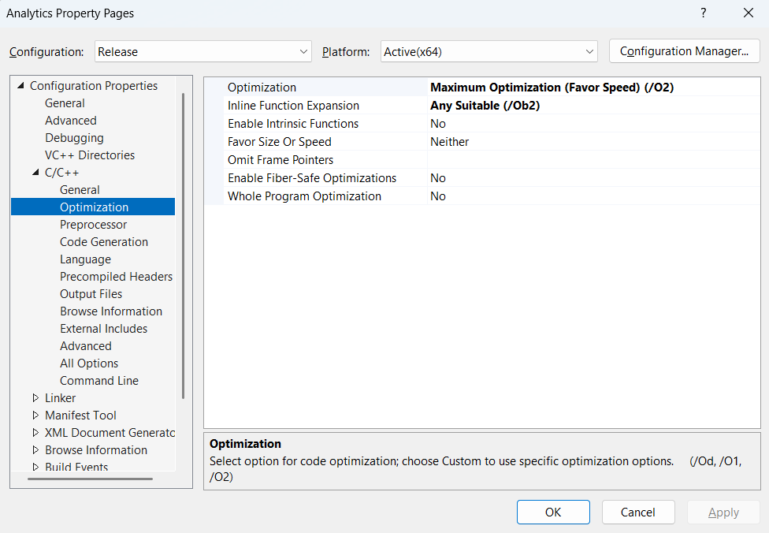
VS Project Properties – C/C++ Compiler

Slide 14
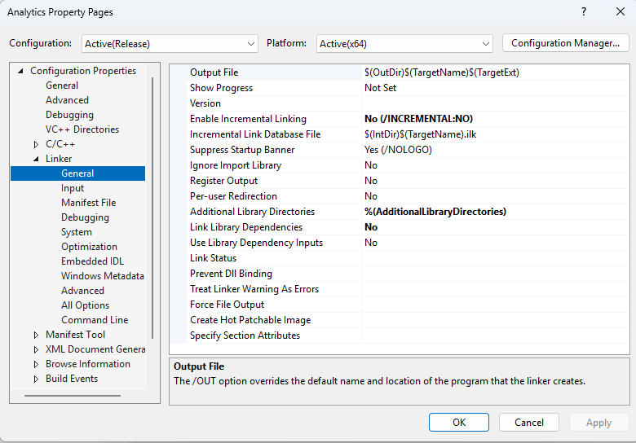
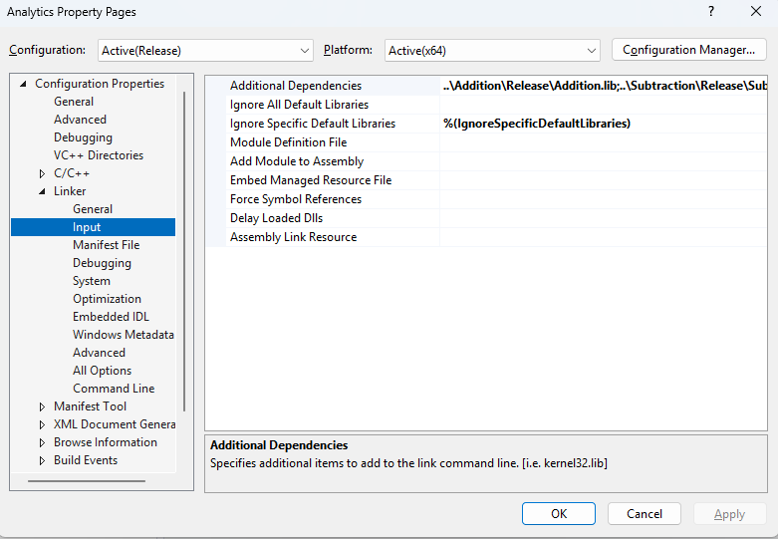
VS Project Properties – Linker/Librarian

Slide 15
Summary – Key Project Properties
General
Output Directory – Specify output path
Configuration Type – Specify the output file type .lib, .exe or .dll
C++ Language Standard – C++14, C++17, C++20 …
C/C++ → General
Additional Include Directories – To link projects, add include folder(s) here
Debug Information Format – Edit and Continue (/ZI) this allows us to make minor modifications with out rebuilding the project
Multi-processor Compilation (Yes /MP) – allows parallel building of .cpp files
C/C++ → Code Generation
Enable C++ Exceptions – /Ehsc allows structured exception handling and helps prevent crashes
Runtime Library – Here we must specify dynamic or static linking of CRT (/MD or /MT), defaults to /MD
Linker → General:
Additional Library Directories - To link projects, add path to .lib files here
Linker → Input:
Additional Dependencies – To link projects, specify .lib path here
Linker → Debugging
Generate Debug Info – To test and debug a release project select /DEBUG

Slide 16
More Info …

Slide 17




Subscribe to my Quant Newsletter
https://algoquanthub.beehiiv.com/subscribe
Subscribe to my Quant YouTube Channel
https://www.youtube.com/@algoquanthub
Algo Trading & Quant Store
https://payhip.com/AlgoQuantHub
Follow me on LinkedIn
https://www.linkedin.com/in/nburgessx

Slide 18
Contact
Have questions or want further info?
LinkedIn: www.linkedin.com/in/nburgessx

